Slide 1
Study Unit 4 Data Management

Slide 2
Import Data

Slide 3
pandas Package
“pandas” is the most common package for data management in Python.
First, installing pandas using pip, then import pandas in our program:
import pandas as pd

Slide 4
Import Data
We need Python compatible datasets to work with pandas.
Load a dataset in Python and open it in the format of pandas.
Convert .csv data files to pandas DataFrame by the read_csv() function.
read_csv() is a reader to convert specific format of data files into pandas DataFrame.
pandas also provides readers to import data files from other sources such as Excel, SPSS, Stata, etc.
DataFrame_name = pd.read_csv("csv_file_name.csv")

Slide 5
pandas Readers
Reader | Format Type | Data Description
read_csv() | text | CSV
read_html() | text | HTML
read_clipboard() | text | Local clipboard
read_excel() | binary | MS Excel
read_stata() | binary | Stata
read_sas() | binary | SAS
read_spss() | binary | SPSS
read_pickle() | binary | Python Pickle Format
read_sql() | SQL | SQL
read_gbq() | SQL | Google BigQuery

Slide 6
Display pandas DataFrames
We can use the print() function to display the whole DataFrame.
Alternatively, display() function achieves the same.
Another possibility is to print the DataFrames without any function.
Use the .head() method to display the first five rows of a DataFrame.
print(DataFrame_name)
display(DataFrame_name)
DataFrame_name
DataFrame_name.head()

Slide 7
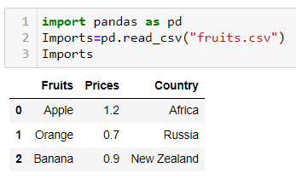
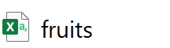
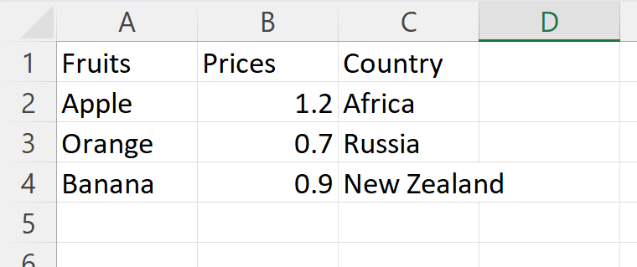
Example of Import & Display
Suppose we have a dataset on fruits, prices, and country of origin
imported as Pandas dataframe and named as Imports
.csv file
Notes:
You can use this path as long as your code and the csv file are located in the same folder.

Slide 8
Data Selection

Slide 9
Select Columns by Variables
Create a list of variable names to select specific columns of a DataFrame.
The variable names must be put within a pair of quotation marks.
To access one column, put the variable name as string inside the index operator directly.
DataFrame_name[["var_name1", "var_name2", …]]

Slide 10
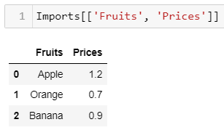
Example of column selection
Suppose we have a dataset on fruits, prices, and country of origin
imported as Pandas dataframe and named as Imports
To get the fruits and their prices, we use Imports[[‘Fruits’, ‘Prices’]]
Notes:
You can use this path as long as your code and the csv file are located in the same folder.

Slide 11
Select Rows by Positions
We cannot refer to natural “observation names” to selecting rows.
pandas provides a row index to every row.
It starts with 0 and ends with the number of rows minus one.
Rows can be queried by the numeric index position using the DataFrame attribute iloc.
The indices must be integers, but they do not need to be consecutive.
If we select multiple rows, the indices must be put in a list first.
If we select one row, the index can be put in the index operator directly.
DataFrame_name.iloc[start:end]

Slide 12
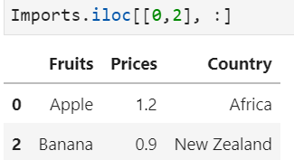
Example of row selection
First row and third row of imports, keep all columns
[0, 2] indicates the first and third rows of Imports
The ‘ : ’ after the comma indicates all columns

Slide 13
Select Cells by Positions and Indices
Specify columns and rows by the .iloc attributes to select cells from a DataFrame.
Use one of the following syntaxes to select cells from a DataFrame:
DF_name.iloc[row_start:row_end, col_start:col_end]
DF_name[["col_labels"]].iloc[row_start:row_end]

Slide 14
Select Cells by Boolean Masking
The elements of a Boolean mask array are either True or False.
Boolean mask array is overlaid on top of the queried DataFrame.
Elements aligned with True are selected.
More complex queries with several conditions are connected by bitwise logical operators.
If there are two conditions, two Boolean masks will be compared elementwise by the bitwise operator.
Each condition needs to be encased in parentheses.
DataFrame_name[Condition]
DataFrame_name[(Condition1) &/| (Condition2) &/| …]

Slide 15
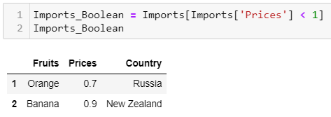
Example of Boolean Masking
Select rows where Prices is smaller than 1

Slide 16
First Activity
Car sales program:
Carry out the following tasks in JupyterLab:
Read in the data file “car_model.csv” into Python as a pandas DataFrame. The data file contains 4 variables: Year, Make, Model, and Category.
Print the DataFrame and check on its dimension.

Slide 17
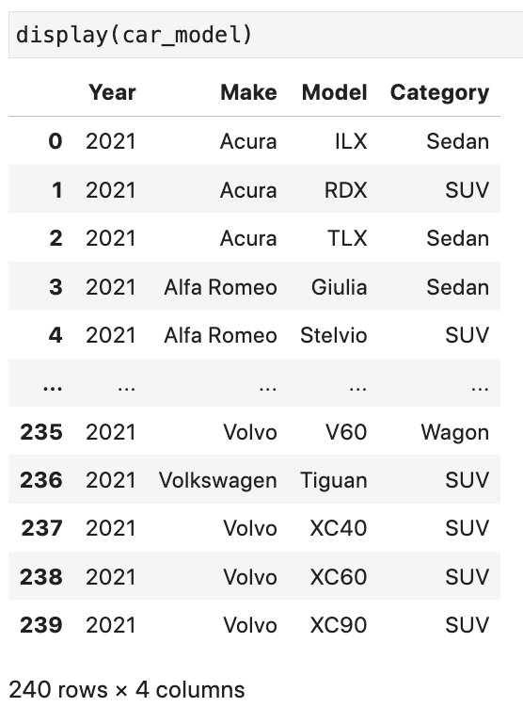
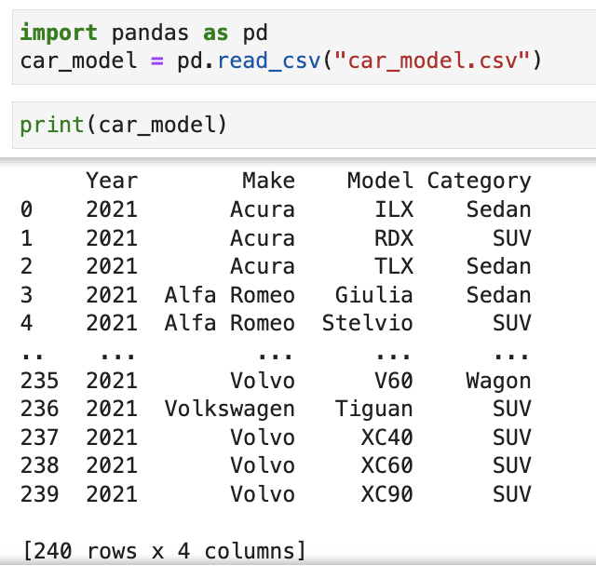
First Activity (Answers)
v

Slide 18
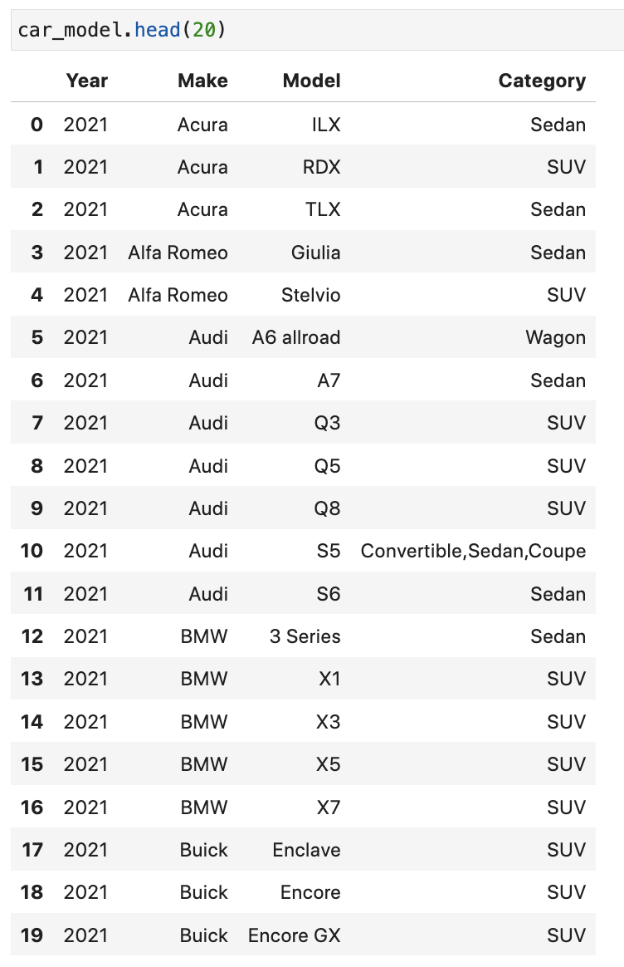
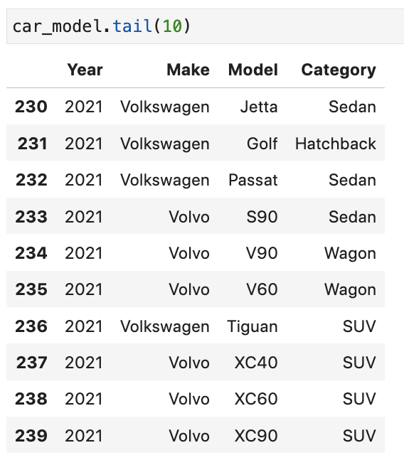
First Activity (Answers)

Slide 19
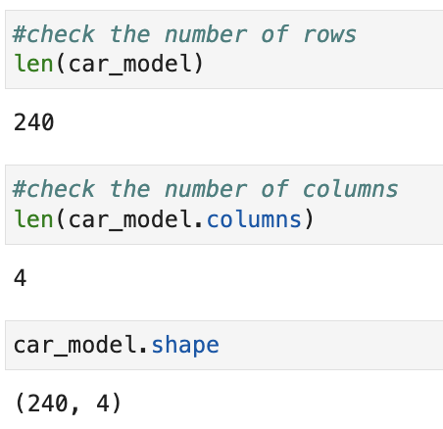
First Activity (Answers)

Slide 20
Second Activity
Car sales program:
Carry out the following tasks in JupyterLab:
Select the column (variable) “Make” from the DataFrame.
Select all entries with the value “Audi” in the variable “Make” from the DataFrame.
Select the last 10 observations and only the variable “Year” from the DataFrame.

Slide 21
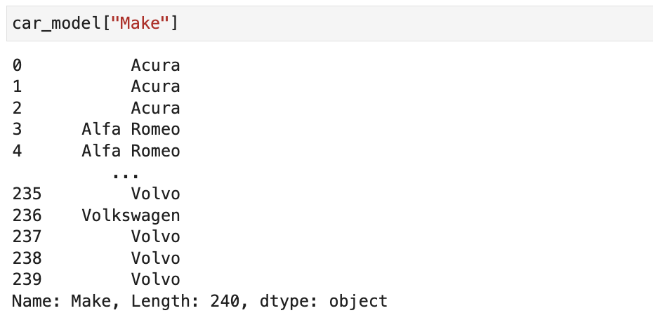
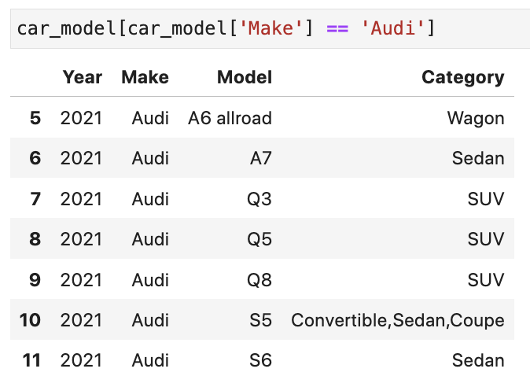
Second Activity (Answers)

Slide 22
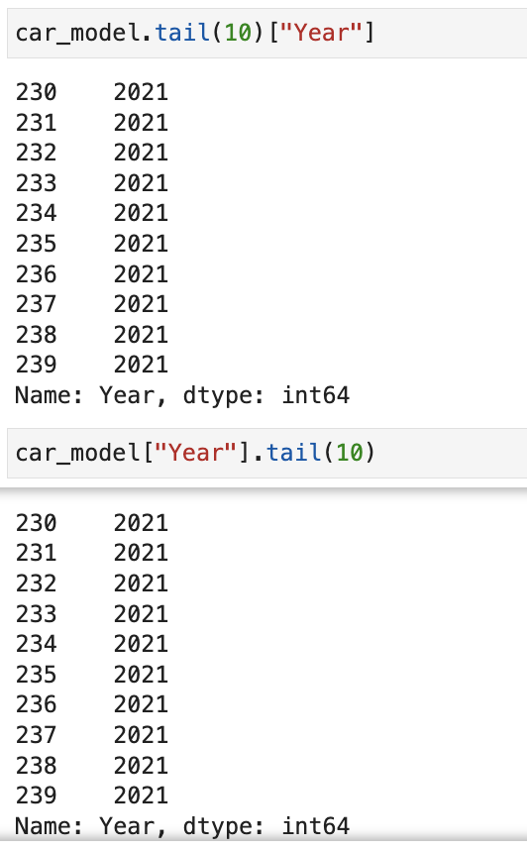
Second Activity (Answers)

Slide 23
Discussion
Name situations where we would need to select data from a DataFrame.
How different are the syntaxes between row and column selections.

Slide 24
Discussion
Name situations where we would need to select data from a DataFrame.
For instance, we only want part of a dataset for our project
How different are the syntaxes between row and column selections
Row selections has no natural row index labels after loading csv file, whereas column does

Slide 25
Merge DataFrame

Slide 26
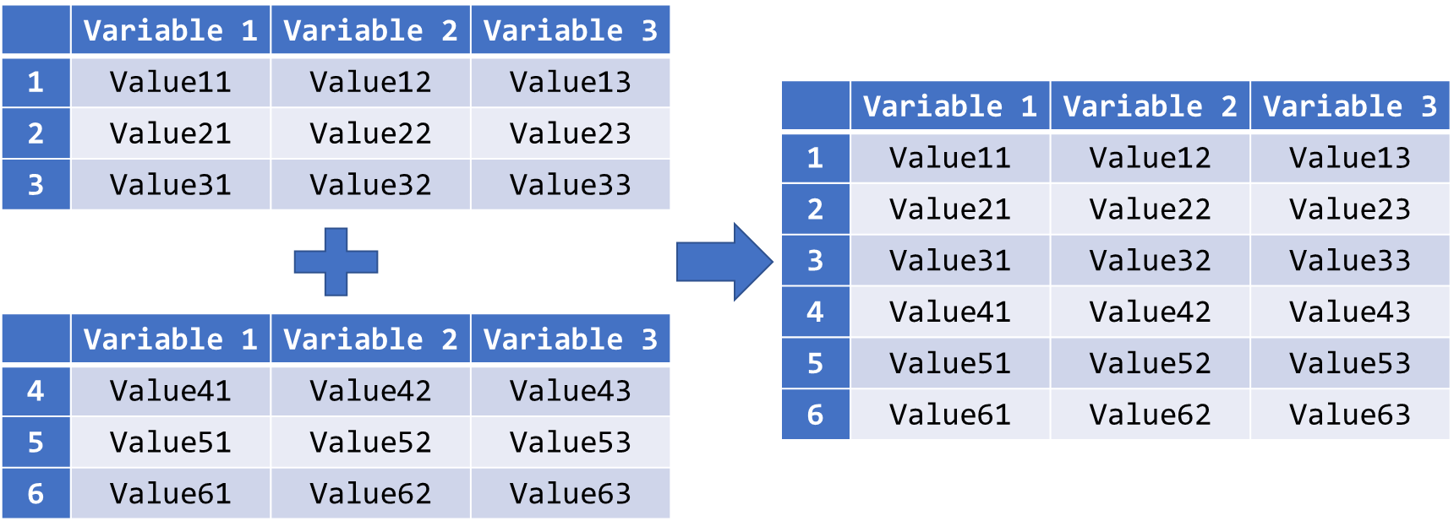
Concatenate DataFrames by Rows
Concatenate two DataFrames with identical variables by rows:
Use the .concat() method for such concatenation:
pd.concat([DataFrame_name, OtherDataFrames])

Slide 27
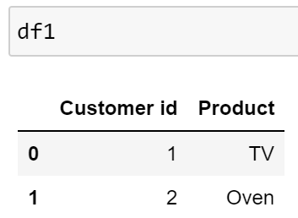
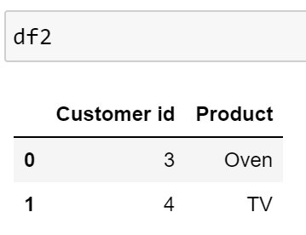
Example Program for Students
Two DataFrames: on customer and product
Please concatenate dataframes by rows

Slide 28
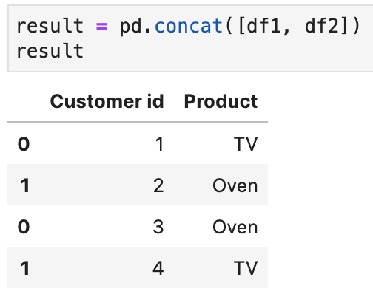
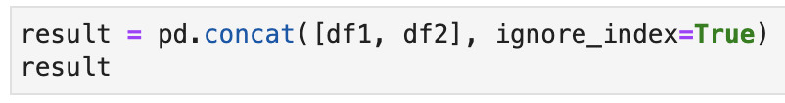
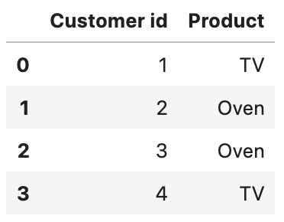
Example Program (Answers)
Two DataFrames: on customer and product
Please concatenate dataframes by rows

Slide 29
Natural Join of DataFrames
Natural Join: Return the rows where the two DataFrames have matching keys (Variable 1).
 | Variable 1 | Variable 2
1 | Value 11 | Value 12
2 | Value 21 | Value 22
3 | Value 31 | Value 32
 | Variable 1 | Variable 3
1 | Value 11 | Value 13
2 | Value 21 | Value 23
4 | Value 41 | Value 43
 | Variable 1 | Variable 2 | Variable 3
1 | Value 11 | Value 12 | Value 13
2 | Value 21 | Value 22 | Value 23
pd.merge(df1, df2, on=‘matching_key’, how=‘inner’)

Slide 30
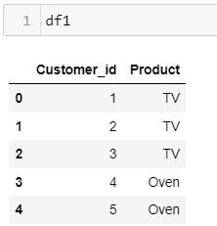
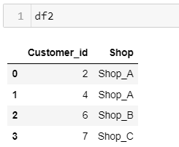
Example Program for Students
Two DataFrames: on customer, product, and shop

Slide 31
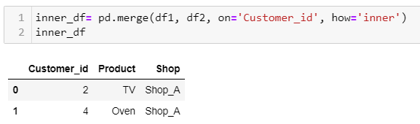
Example Program (Answers)
Two DataFrames: on customer, product, and shop

Slide 32
Missing Data and Outliers

Slide 33
Missing Data
In empirical studies, an observed value of a variable could be missing.
Reasons for missing data: defective measurement tools, withdrawal from the study, refusal of responses to sensitive questions, etc.
In Python, pandas indicates missing data with a special floating-point value, while NumPy uses NaN (“Not a Number”).
Missing data cannot be included in constructing models, forecasting, etc.
In pandas, missing values are ignored by the statistical functions.
Since the underlying sample sizes for each variable could vary in the computation due to missing data, the statistical estimation can be biased.

Slide 34
Identify Missing Data
pandas’ readers such as read_csv() have two parameters, na_filter and na_values, to convert certain strings to missing values directly.
By default na_filter is True, pandas will convert all white spaces "" to NaN.
With na_values, we can declare certain strings from our DataFrame to be recognised as missing values.
The following strings are treated as missing values by default and do not require explicit declaration:
"", "#N/A", "#N/A N/A", "#NA", "-1.#IND", "-1.#QNAN", "-NaN", "-nan", "1.#IND", "1.#QNAN", "N/A", "NA", "NULL", "NaN", "n/a", "nan", "null"
DataFrame_name = pd.read_csv("csv_file_name.csv", na_values = "na_string", na_filter = True/False)

Slide 35
Locate Missing Data (I)
It is often not easy to locate the missing data in a dataset.
Count the NaNs in each row and each column to find the missing data.
Missing values exist in a variable if the number of NaNs is larger than zero.
Same approach is applicable to rows.
The method .isnull() checks every cell of a DataFrame and returns True if the cell contains a missing value and False otherwise.
The method .sum() adds up all the “True” (equal to 1) in each row or each column. It is equivalent to counting the missing values.
If axis = 0, the values in a column will be added up together. If axis = 1, it returns the sum of a row.
DataFrame_name.isnull().sum(axis = 0/1)

Slide 36
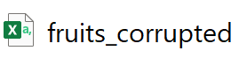
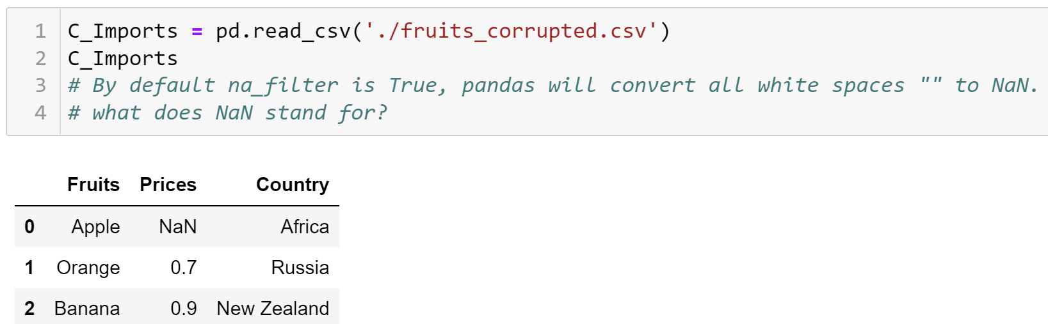
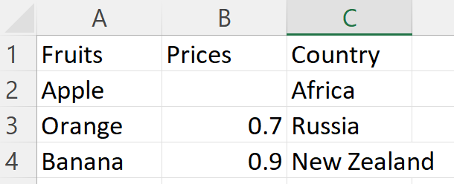
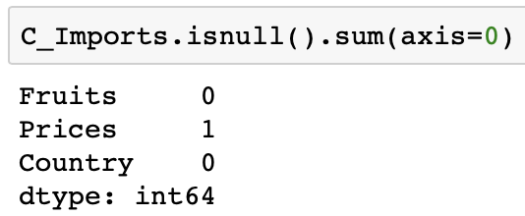
Example of Locating Missing Data (I)
Suppose our Imports dataset is corrupted, name it as C_Imports
Observe that the price of apple is missing, NaN
Now locate the missing data; there is 1 missing value in Prices
.csv file

Slide 37
Locate Missing Data (II)
We can use .any() just to check whether missing data exist.
It returns True if any element in the attached array is True.
Retrieve the row/column indices with missing data by .index.
Counting the NaNs in columns means to check on the existence of missing values in each variable.
Counting the NaNs in rows means to identify observations with missing values in at least one of the variables.
The treatments of missing data are different in these two cases.
DataFrame_name.isnull().any(axis = 0)
DataFrame_name.isnull().any(axis = 1)
object_name = DataFrame_name.isnull().any()
object_name[object_name == True].index

Slide 38
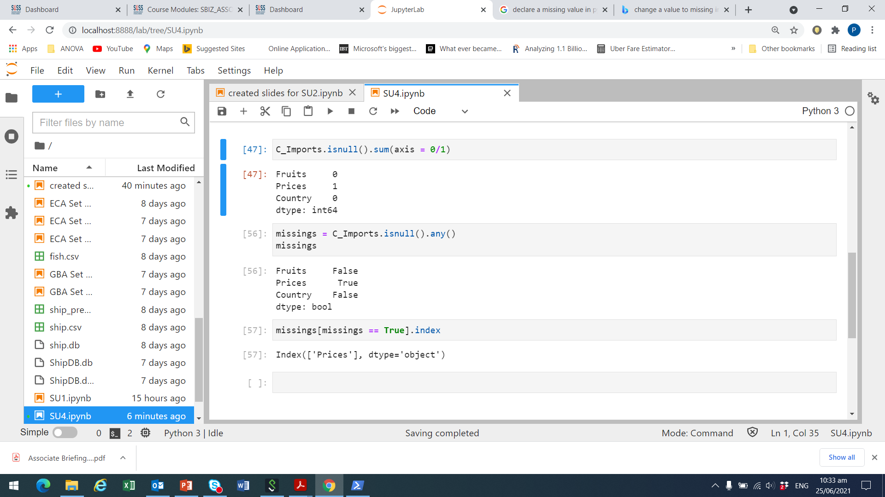
Example of Locating Missing Data (II)
Check for missing entries in C_Imports. Recall that price is missing
We see a ‘True’ for ‘Prices’
Now check the index which is missing
We see a ‘True’ for ‘Prices’

Slide 39
Delete Missing Data
The usual ways to treat missing data are:
delete the entire observations
replace them
ignore them
With .drop(), we specify the row indices with missing values that should be removed.
The .dropna() method combines the localisation and removal of rows or columns with missing data in a single function.
All missing values are treated and deleted by .dropna() equally.
axis=0/axis=1: rows (0) or columns (1) should be dropped.
DF_name.drop(axis = 0, index = [index1, index2, …])
DF_name.dropna(axis = 0, how = "any"/"all")

Slide 40
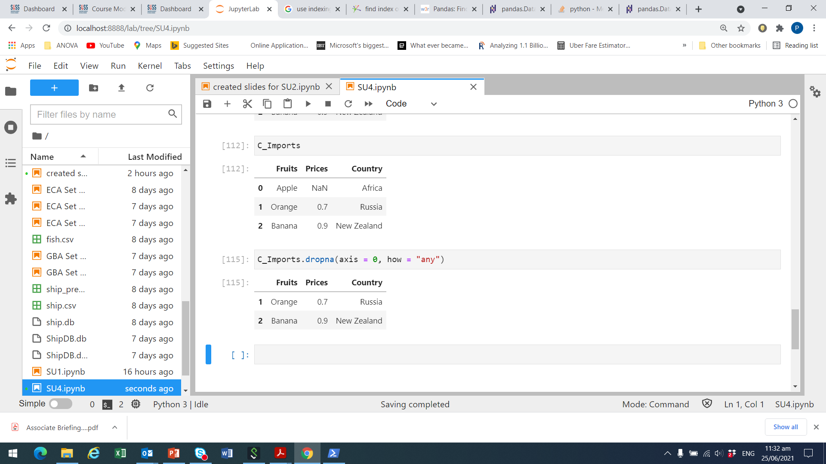
Example of Deleting Missing Data
Recall that Prices for Apple is missing in C_Imports.
We set how = “any” to drop the row for Apple with NaN for Prices.

Slide 41
Replace Missing Data
We can also replace missing values by a pre-defined value.
Variable mean, mode, etc.
pandas facilitates replacement of missing values by .fillna().
The .fillna() method replaces all missing values with the value specified in the parameter.
We can also specify a column in the DataFrame where the missing values should be replaced by the .fillna() method.
DataFrame_name.fillna(value = repl_value)
DataFrame_name["column_label"].fillna(value = repl_value)

Slide 42
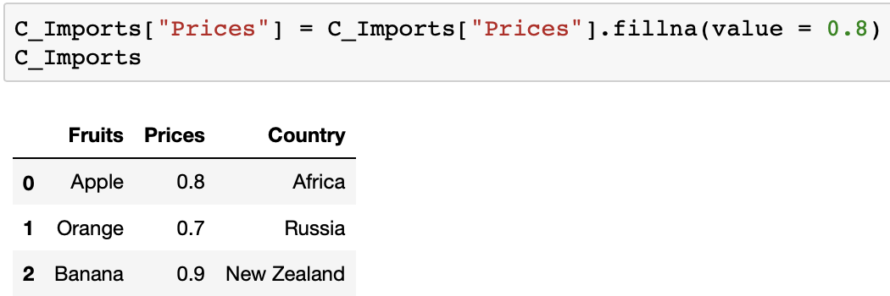
Example of Replacement
Recall that Prices for Apple is missing in C_Imports (i.e., NaN)
Replace NaN with the mean price of orange and banana
Mean is (.7 + .9) / 2 = .8

Slide 43
Outliers
Outliers can cause biasedness in the statistical estimation.
Draw histogram/boxplot or use interquartile range (IQR) to detect outliers in a variable.
Use .quantile() to determine the 1st and 3rd quartiles of a variable.
An observation y is considered as outliers if:
y < q1 – 1.5 * iqr or y > q3 + 1.5 * iqr
where q1 is the 1st quartile, q3 the third quartile and iqr = q3 – q1 is the interquartile range.
DataFrame_name["column_label"].quantile(q = quantile)
q=0.25 (0.25 quantile)
q=0.75 (0.75 quantile)

Slide 44
Detect and Remove Outliers
Usually, outliers should be removed from the dataset.
In Python, it suffices to select observations with no outliers in the target variable.
The following syntax generates a subset of rows that do not fulfil the outlier condition.
DF[~((DF["Col"]<q1–1.5*iqr) | (DF["Col"]>q3+1.5*iqr))]

Slide 45
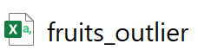
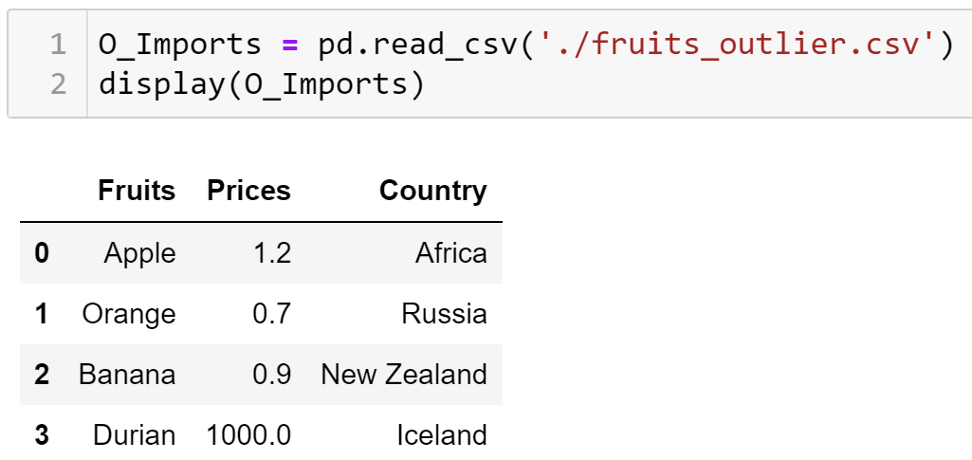
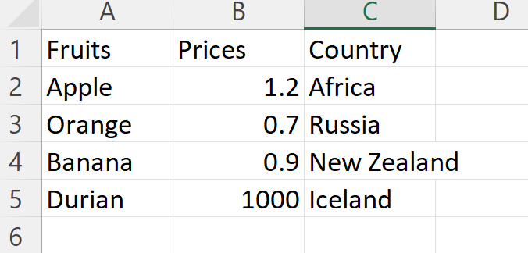
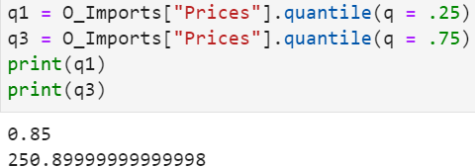
Example of Outliers (I)
Suppose our fruit imports dataset, ‘O_Imports’, now has 1 outlier
Durian with Prices of 1,000, from Iceland; looks suspicious
Obtain the 1st quartile (q = .25) and 3rd quartile (q = .75)
.csv file

Slide 46
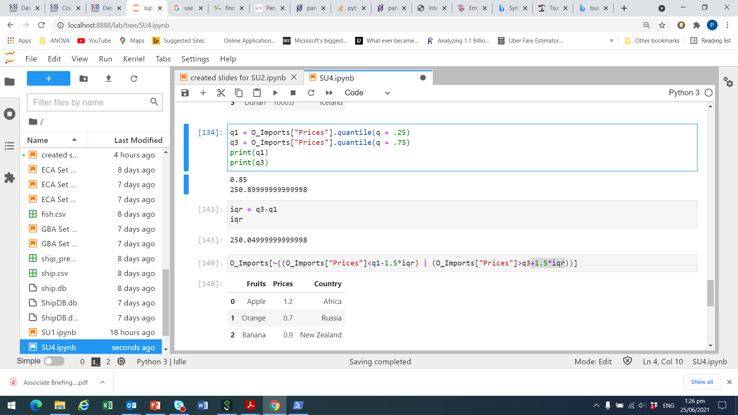
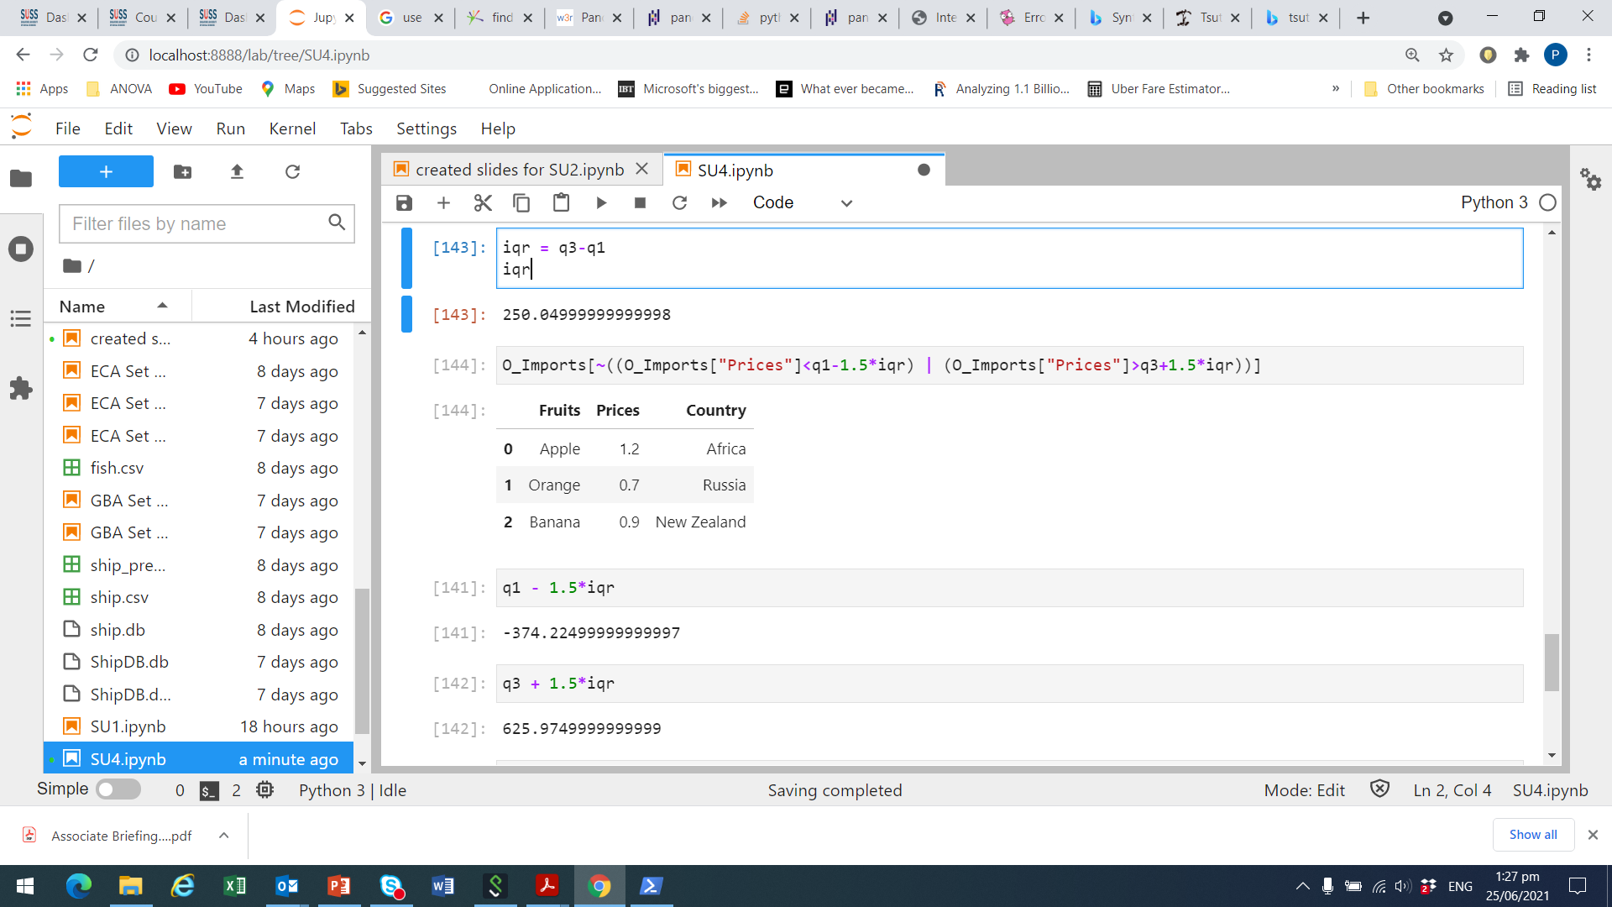
Example of Outliers (II)
Define interquartile range, iqr, as q3 – q1
Find the observations which are not outliers
Hence, Durians from Iceland with a Price of 1,000 is an outlier

Slide 47
Third Activity
Car sales program:
Carry out the following tasks in JupyterLab:
Remove all the rows with missing data in “price” from the ‘car_price_model.csv’.
Detect car models that can be considered as outliers in terms of their selling price.
Discuss whether the models with extraordinarily high/low selling prices should be excluded from the DataFrame.

Slide 48
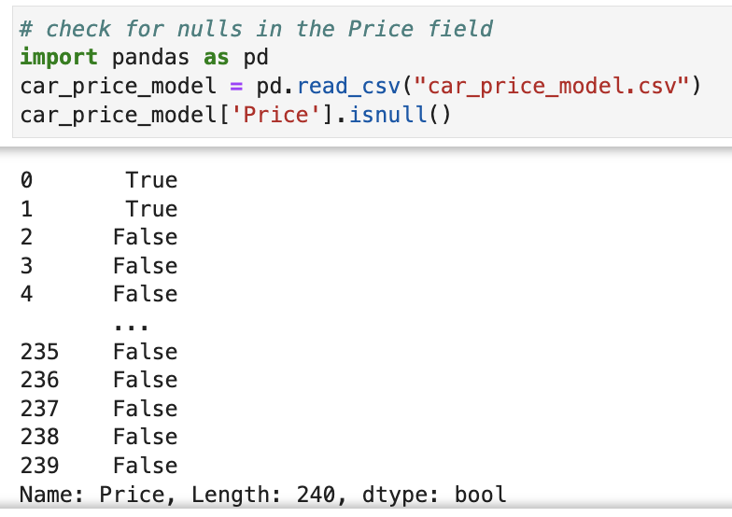
Third Activity (Answers)

Slide 49
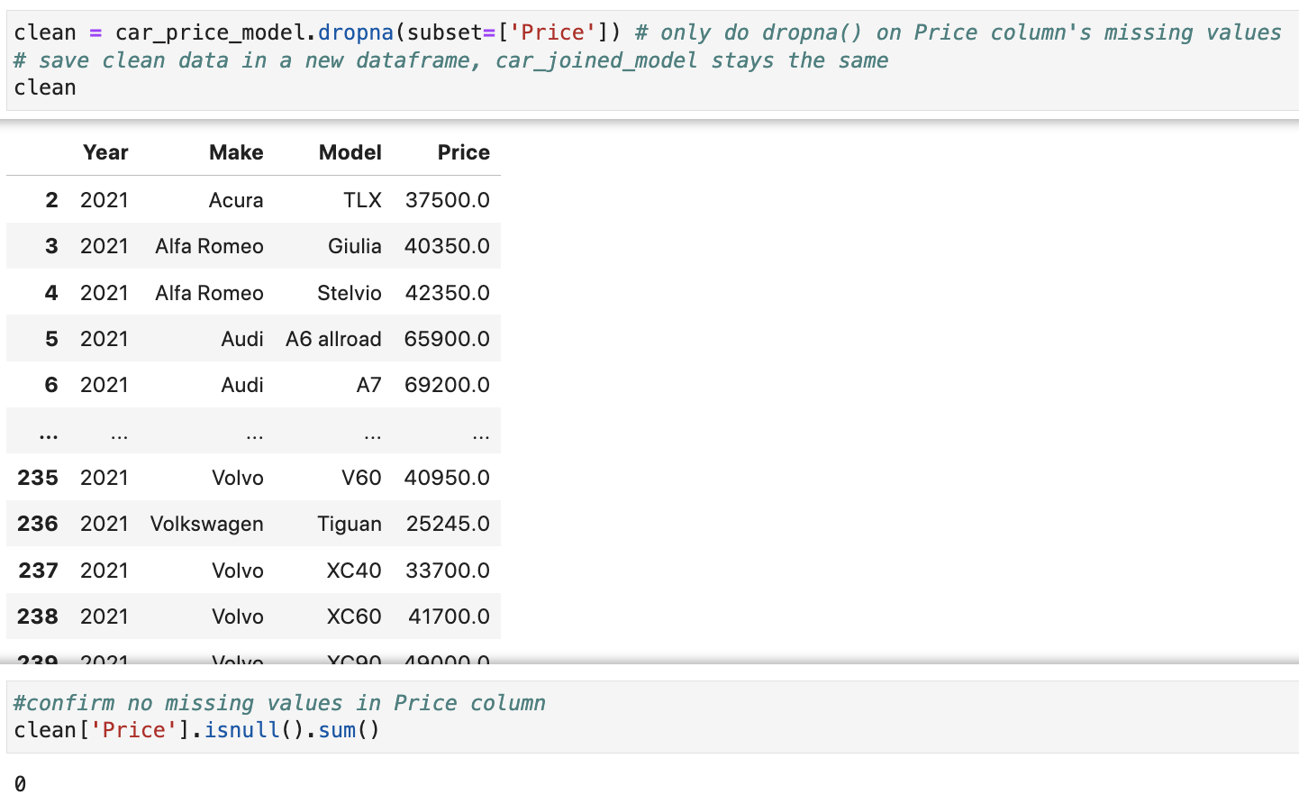
Third Activity (Answers)

Slide 50
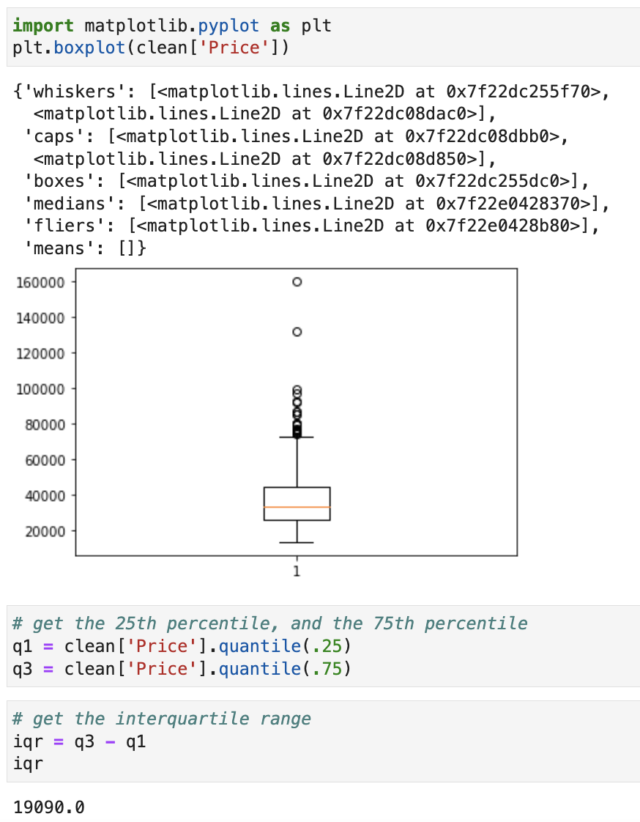
Third Activity (Answers)

Slide 51
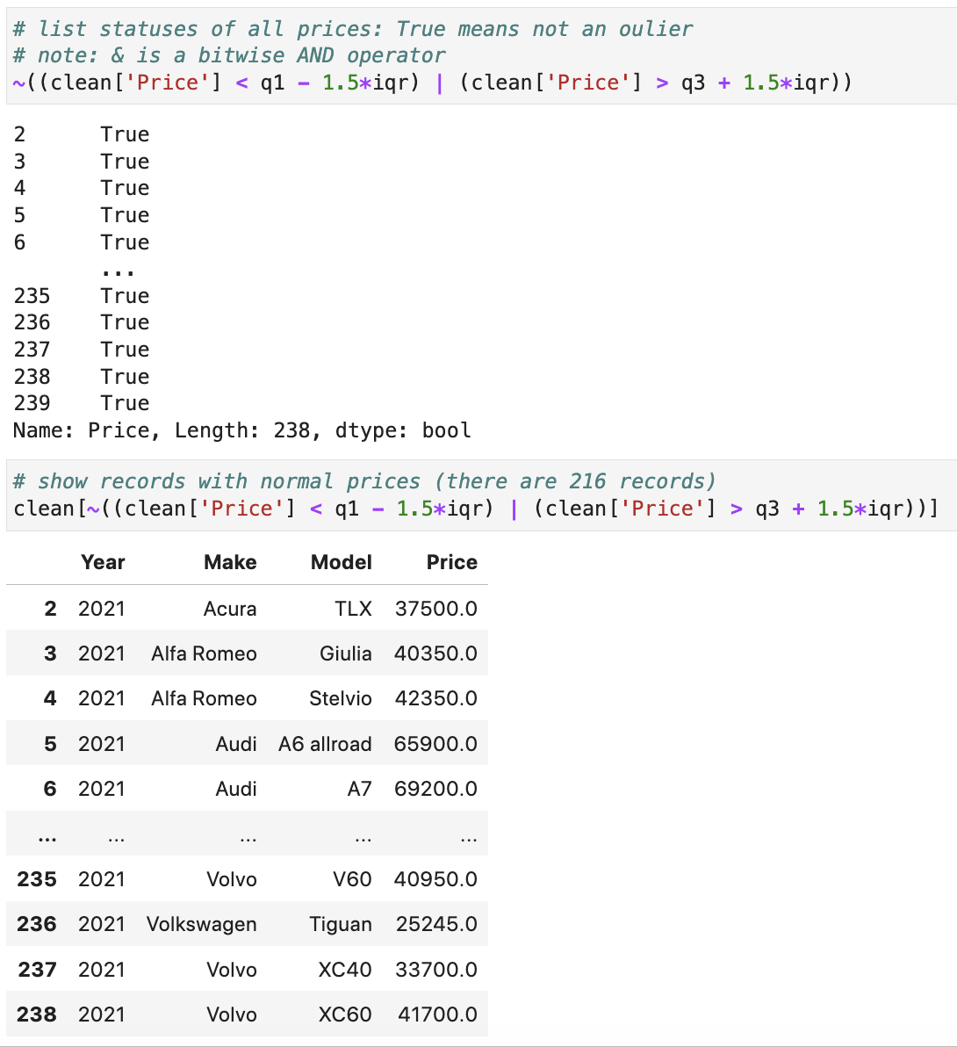
Third Activity (Answers)

Slide 52
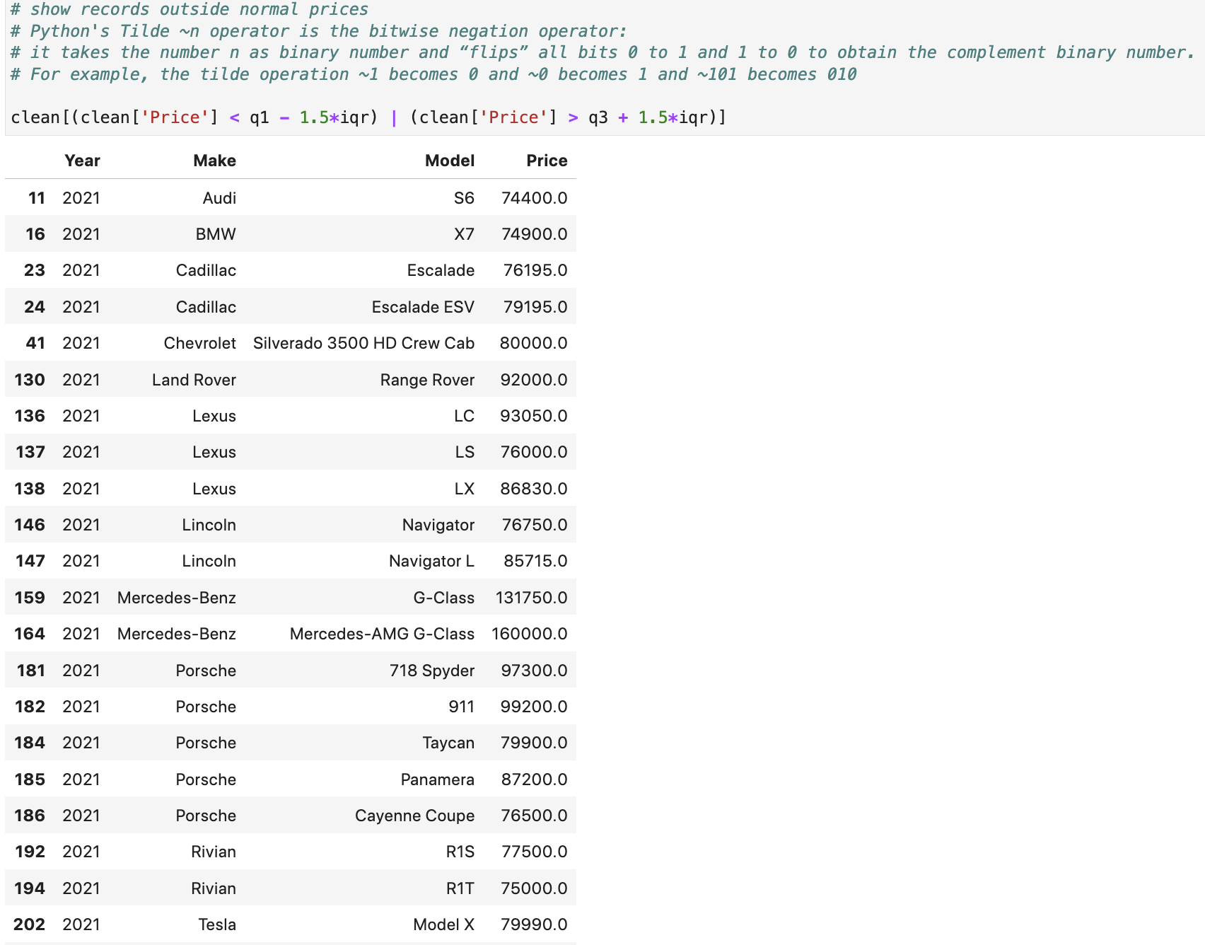
Third Activity (Answers)

Slide 53
Data Modification

Slide 54
Sort Data
Sometimes, we may want to sort the data according to the values of some variables for better understanding.
The method .sort_values() rearranges the order of the rows in a DataFrame.
A list of variable names based on which the DataFrame is sorted must be provided.
The sorting hierarchy among these variables drops with the increasing index in the list.
Data can be sorted in the ascending or descending order.
DataFrame_name.sort_values( by = [List_of_var_names], ascending=True)

Slide 55
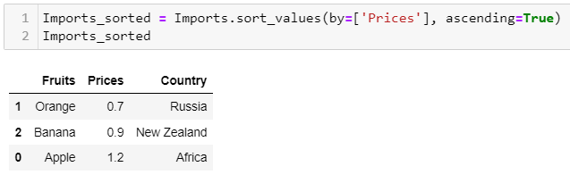
Example of Data Sorting
Sort the DataFrame by the column ‘Prices’ in ascending order
Notes:
You can use this path as long as your code and the csv file are located in the same folder.

Slide 56
Grouping Data
Analysing aggregated statistics of some variables are often of interest in data analytics.
Aggregated statistics are calculated based on grouped data.
A DataFrame can be grouped by one or more variables using the .groupby() method.
Attached to the .groupby() method can be any method for the calculation of the aggregated statistics.
DataFrame_name.groupby(by = [List_of_Labels]).anymethod()

Slide 57
Fourth Activity
Car sales program:
Carry out the following tasks in JupyterLab:
Read in the data file “car_price_model.csv” into Python as a pandas DataFrame. The data file contains 4 variables: Year, Make, Model, and Price.
Print the DataFrame and check on its dimension.
Drop the rows where at least one element is missing.
Since the prices stored in the “Price” variable are in US dollars, add a new column named “SGD Price” that is 1.5 times of the “Price”
Sort the dataset by “SGD Price” in ascending order
Calculate the mean “SGD Price” of each car Make

Slide 58
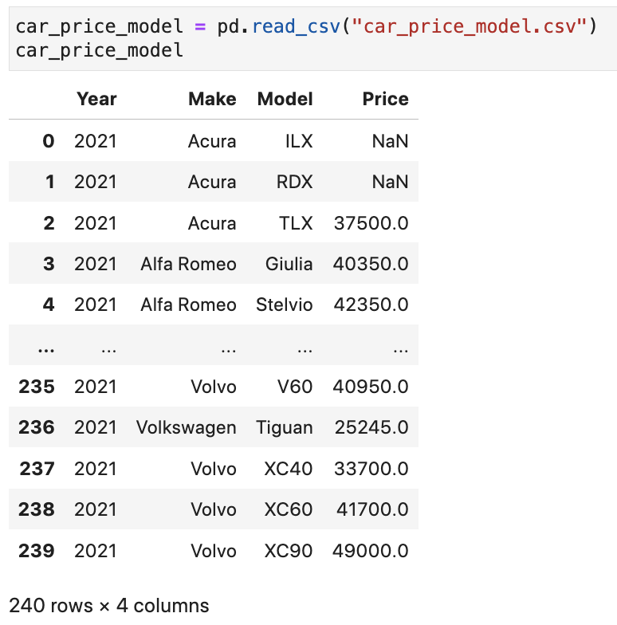
Fourth Activity (Answers)

Slide 59
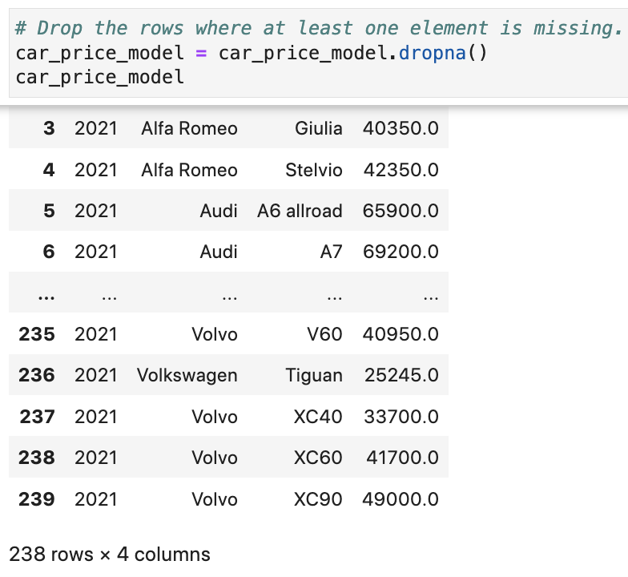
Fourth Activity (Answers)

Slide 60
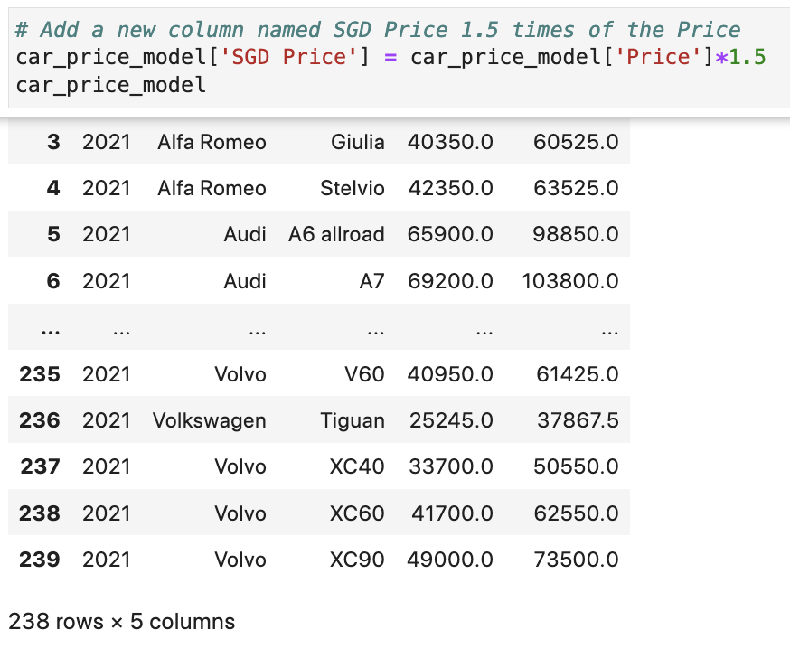
Fourth Activity (Answers)

Slide 61
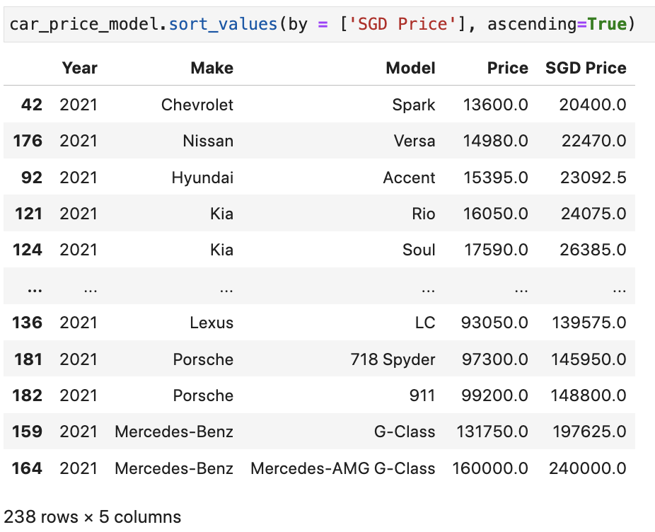
Fourth Activity (Answers)

Slide 62
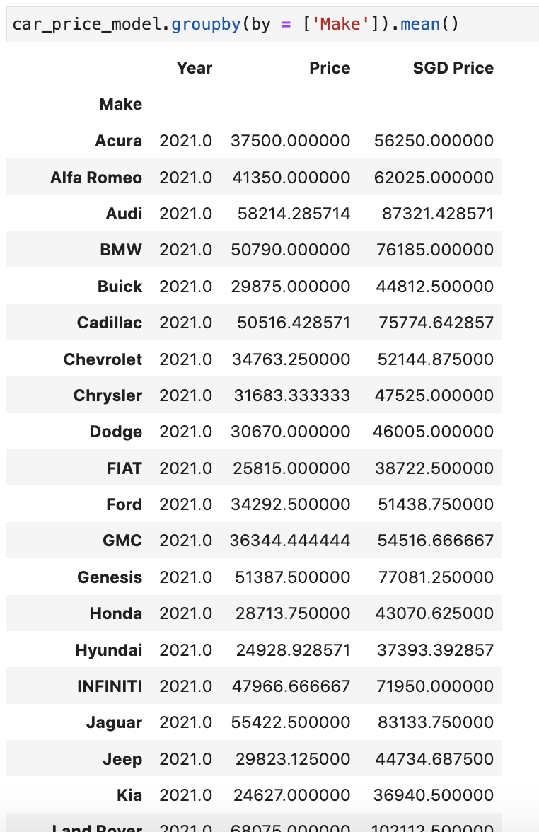
Fourth Activity (Answers)

Slide 63
Online Learning Platform (Optional)
Pandas Read CSV:
https://www.w3schools.com/python/pandas/pandas_csv.asp
Pandas DataFrames:
https://www.w3schools.com/python/pandas/pandas_dataframes.asp

